Slide 1

Relational Calculus
Dr. Sanjeev Kumar
Asst. Professor

Slide 2
Relational Calculus
Relational calculus is a non-procedural query language. In the non-procedural query language, the user is concerned with the details of how to obtain the end results.
The relational calculus tells what to do but never explains how to do.

Slide 3
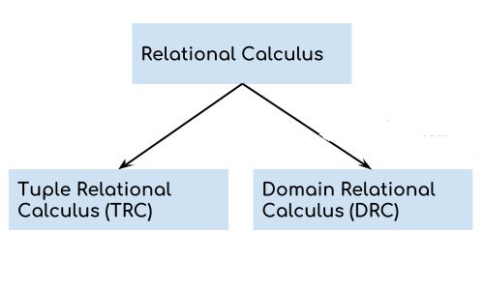
Types of Relational Calculus

Slide 4
1. Tuple Relational Calculus (TRC)
Tuple relational calculus is used for selecting those tuples that satisfy the given condition.
Notation:
{T | P (T)} or {T | Condition (T)}
Where
T is the resulting tuples
P(T) is the condition used to fetch T.
For example:
{ T.name | Author(T) AND T.article = 'database' }

Slide 5
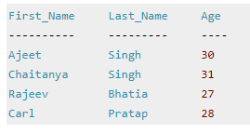

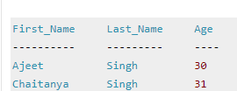
Query to display the last name of those students where age is greater than 30
{ t.Last_Name | Student(t) AND t.age > 30 }
Query to display all the details of students where Last name is ‘Singh’
{ t | Student(t) AND t.Last_Name = 'Singh' }

Slide 6
Tuple Relational Calculus
Example: To find the first and last names of all employees whose salary is above $50,000, we can write the following tuple calculus expression:
{t.FNAME, t.LNAME | EMPLOYEE(t) AND t.SALARY>50000}
The condition EMPLOYEE(t) specifies that the range relation of tuple variable t is EMPLOYEE.
The first and last name (PROJECTION π_{FNAME, LNAME}) of each EMPLOYEE tuple t that satisfies the condition t.SALARY>50000 (SELECTION σ _{SALARY >50000}) will be retrieved.
Slide 6- <number>

Slide 7
TRC (tuple relation calculus) can be quantified. In TRC, we can use Existential (∃) and Universal Quantifiers (∀).
For example:
{ R| ∃T ∈ Authors(T.article='database' AND R.name=T.name)}
Output: This query will yield the same result as the previous one.

Slide 8
The Existential and Universal Quantifiers
∀ is called the universal or “for all” quantifier because every tuple in “the universe of” tuples must make F true to make the quantified formula true.
∃ is called the existential or “there exists” quantifier because any tuple that exists in “the universe of” tuples may make F true to make the quantified formula true.
Slide 6- <number>

Slide 9
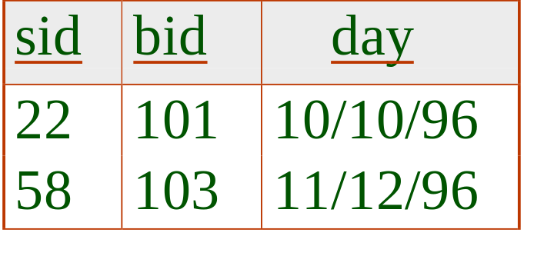
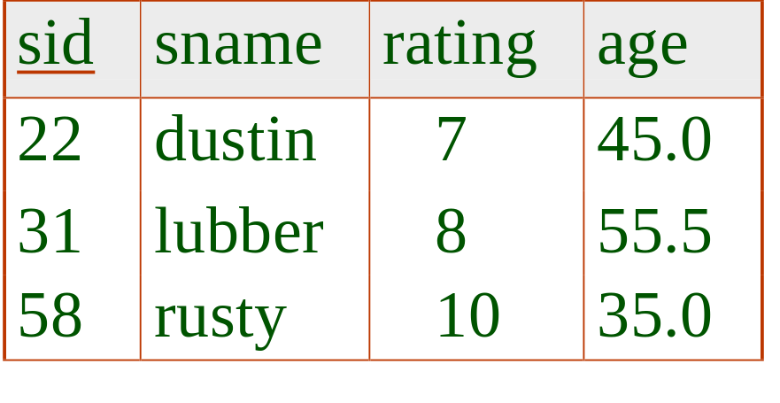
TRC Example
Reserves
Sailors

Slide 10
Find the names and ages of sailors with rating > 7
{ P | ∃S ∈ Sailors (S.rating > 7 ∧ P.name = S.sname ∧ P.age = S.age)}
P is a Tuple variable with two fields: name and age.
    - the only fields mentioned in P
    - P does not range over any relation in the query.
Sailors
name | age
Lubber | 55.0
rusty | 35.0

Slide 11
Find the names of the sailors who reserved boat 103
{ P | ∃S ∈ Sailors ∃R ∈ Reserves
(R.sid = S.sid ∧ R.bid = 103 ∧ P.sname = S.sname)}
Retrieve all sailor tuples for which there exists a tuple in
Reserves having the same value in the sid field and with
bid =103
Question:
How is the answer tuple looks like? (columns? Rows?)
What is difference?
{ S | ∃S ∈ Sailors ∧ ∃R ∈ Reserves (R.sid = S.sid ∧ R.bid = 103)}

Slide 12
Find the sailors who have reserved all red boat
{ P | ∃S ∈ Sailors ∧ ∀B ∈ Boats
(B.color = 'red'
⇒ (∃R ∈ Reserves (S.sid = R.sid ∧ R.bid = B.bid))}
Question: How to change the algebraic representation?

Slide 13
Domain Relational Calculus (DRC)
The second form of relation is known as Domain relational calculus. In domain relational calculus, filtering variable uses the domain of attributes.
Domain relational calculus uses the same operators as tuple calculus. It uses logical connectives ∧ (and), ∨ (or) and ┓ (not).
It uses Existential (∃) and Universal Quantifiers (∀) to bind the variable.

Slide 14
Notation:
{ a1, a2, a3, ..., an | P (a1, a2, a3, ... ,an)}
Where
a1, a2 are attributes
P stands for formula built by inner attributes
For example:
{< article, page, subject > | ∈ cse ∧ subject = 'database'}
Output: This query will yield the article, page, and subject from the relational cse, where the subject is a database
Query to find the first name and age of students where student age is greater than 27
{< First_Name, Age > | ∈ Student ∧ Age > 27}

Slide 15
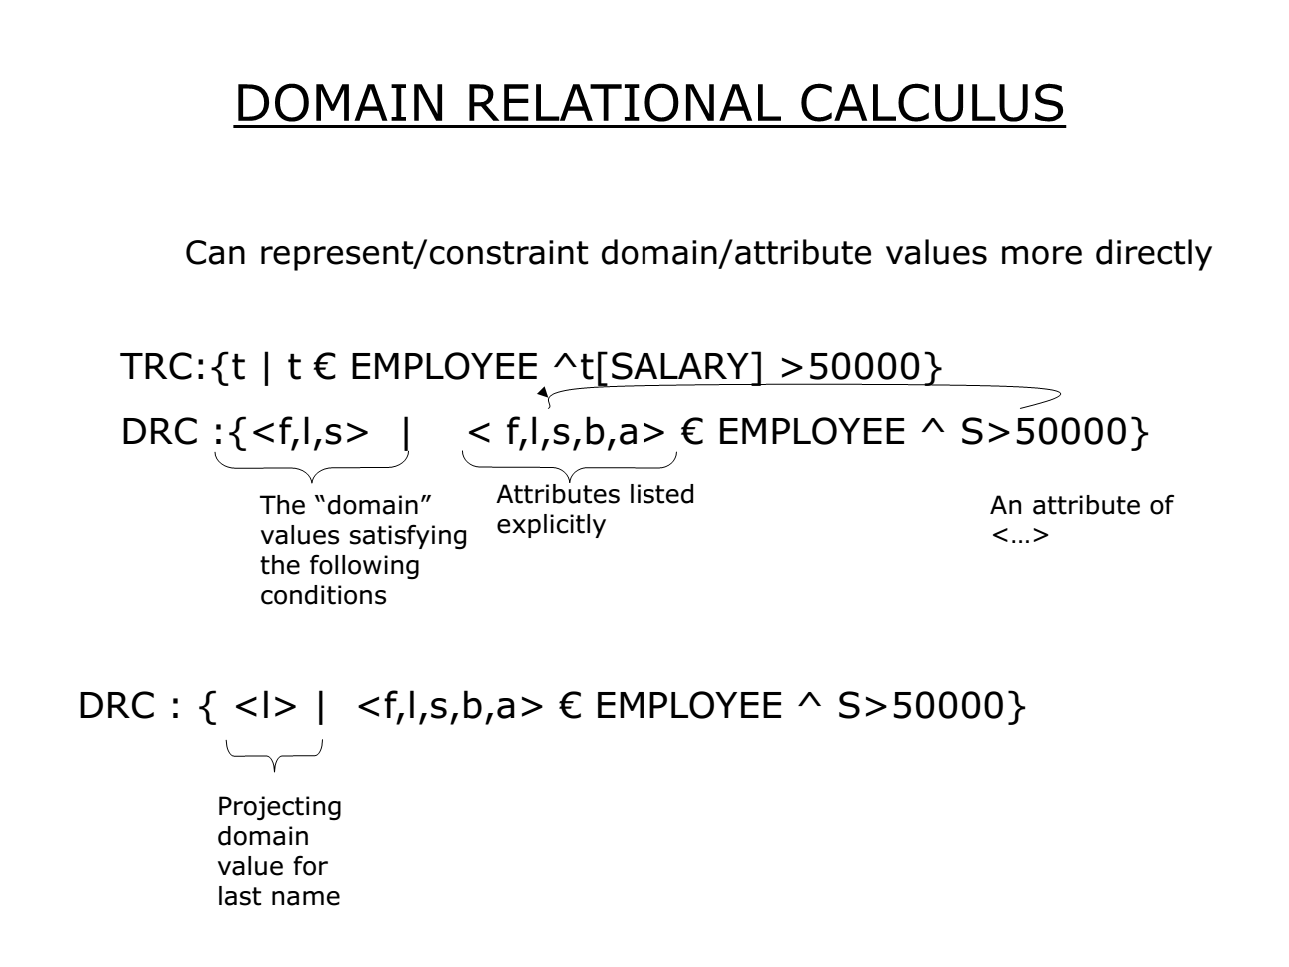

Slide 16
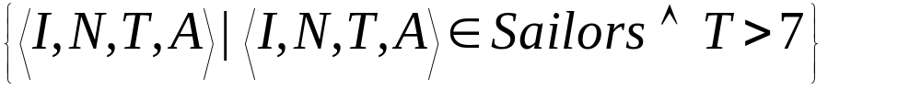
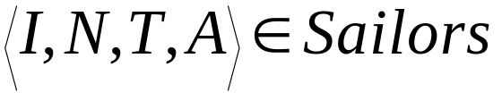
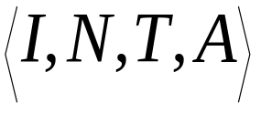
Find all sailors with a rating above 7
Sailors
the domain variables I, N, T and A are bound to fields of the same Sailors tuple.
that every tuple that satisfies T>7 is in the answer.
Question: Modify to answer:
  Find sailors who are older than 18 or have a rating under 9, and are called ‘Joe’.

Slide 17


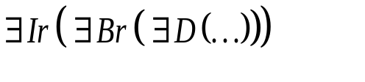

Find sailors rating > 7 who’ve reserved boat #103
Sailors
Reserves
Boats
bid | bname | color
101 | interlake | red
103 | marine | green
We have used as a shorthand for
Note the use of to find a tuple in Reserves that `joins with’ the Sailors tuple under consideration.
{<I,N,T,A>|<I,N,T,A> ∈Sailors ∧T>7
∧ ∃ Ir,Br,D
(<Ir,103,D> ∈ Reserves ∧ Ir =I )}

Slide 18
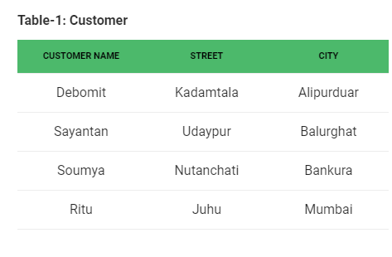
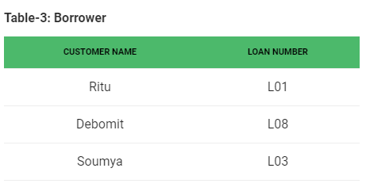
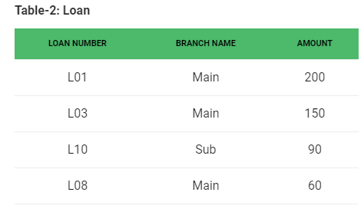

Slide 19
Query-1: Find the loan number, branch, amount of loans of greater than or equal to 100 amount.
{≺l, b, a≻ | ≺l, b, a≻ ∈ loan ∧ (a ≥ 100)}
Query-2: Find the loan number for each loan of an amount greater or equal to 150.
{≺l≻ | ∃ b, a (≺l, b, a≻ ∈ loan ∧ (a ≥ 150)}
Query-3: Find the names of all customers having a loan at the “Main” branch and find the loan amount .
{≺c, a≻ | ∃ l (≺c, l≻ ∈ borrower ∧ ∃ b (≺l, b, a≻ ∈ loan ∧ (b = “Main”)))}

